Slide 1
Accounting Principles
Thirteenth Edition
Weygandt ● Kimmel ● Kieso
Chapter 22
Cost-Volume-Profit
This slide deck contains animations. Please disable animations if they cause issues with your device.

Slide 2
Chapter Outline
Learning Objectives
L O 1 Explain variable, fixed, and mixed costs and the relevant range.
L O 2 Apply the high-low method to determine the components of mixed costs.
L O 3 Prepare a C V P income statement to determine contribution margin.
L O 4 Compute the break-even point using three approaches.
L O 5 Determine the sales required to earn target net income and determine margin of safety.

Slide 3
Cost Behavior Analysis (1 of 5)
Cost Behavior Analysis is the study of how specific costs respond to changes in the level of business activity.
Some costs change; others remain the same
Helps management plan operations and decide between alternative courses of action
Applies to all types of businesses and entities
Starting point is measuring key business activities

Slide 4
Cost Behavior Analysis (2 of 5)
Activity levels may be expressed in terms of:
Sales dollars (in a retail company)
Miles driven (in a trucking company)
Room occupancy (in a hotel)
Dance classes taught (by a dance studio)
Many companies use more than one measurement base

Slide 5
Cost Behavior Analysis (3 of 5)
Changes in level or volume of activity should be correlated with changes in costs
Activity level selected is called activity index or driver
Activity index:
Identifies activity that causes changes in behavior of costs
Allows costs to be classified as variable, fixed, or mixed

Slide 6
Variable Costs (1 of 4)
Costs that vary in total directly and proportionately with changes in the activity level
Example: If activity level increases 10 percent, total variable costs increase 10 percent
Example: If activity level decreases by 25 percent, total variable costs decrease by 25 percent
Variable costs remain the same per unit at every level of activity

Slide 7
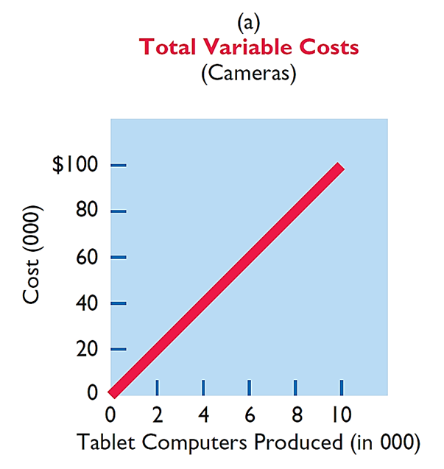
Variable Costs (2 of 4)
Illustration: Damon Company manufactures tablet computers that contain cameras that cost $10. The activity index is the number of tablet computers produced. As Damon manufactures each tablet, the total cost of cameras installed in tablets increases by $10. As part (a) of Illustration 22.1 shows, total cost of the cameras will be $20,000 (2,000 × $10) if Damon produces 2,000 tablets, and $100,000 when it produces 10,000 tablets. We also can see that a variable cost remains the same per unit as the level of activity changes.

Slide 8
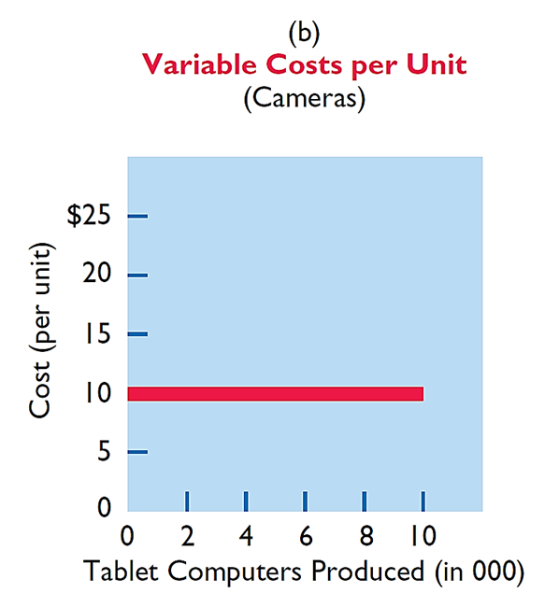
Variable Costs (3 of 4)
Illustration: Damon Company manufactures tablet computers that contain cameras that cost $10. The activity index is the number of tablet computers produced. As Damon manufactures each tablet, the total cost of cameras installed in tablets increases by $10. As part (b) of Illustration 22.1 shows, the unit cost of $10 for the camera is the same whether Damon produces 2,000 or 10,000 tablets.

Slide 9
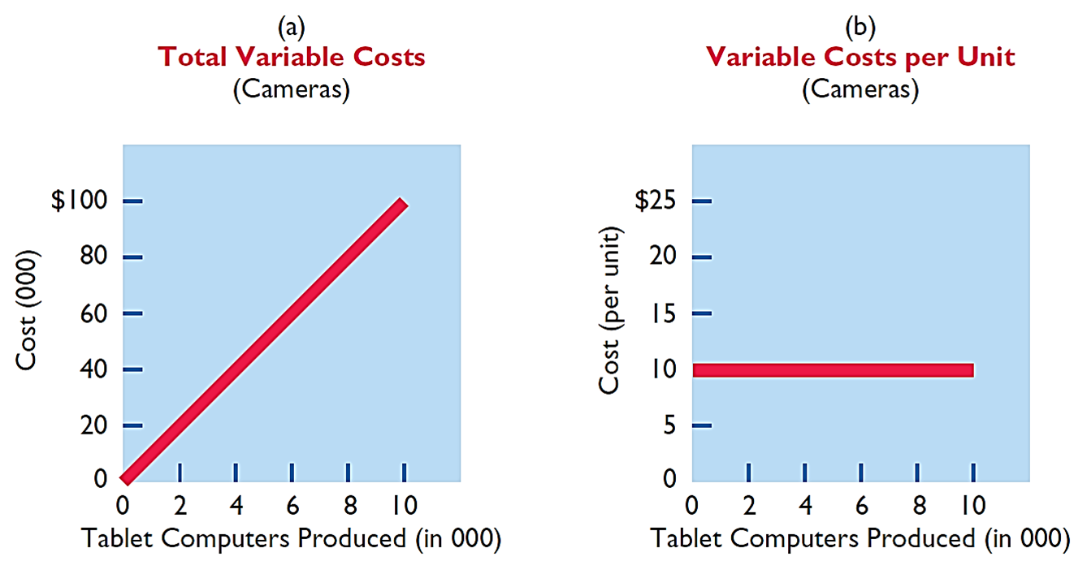
Variable Costs (4 of 4)

Slide 10
Fixed Costs (1 of 4)
Costs that remain the same in total regardless of changes in the activity level within a relevant range
Fixed cost per unit cost varies inversely with activity: As volume increases, unit cost declines, and vice versa
Examples:
Property taxes
Supervisory salaries
Insurance
Rent
Depreciation on buildings and equipment

Slide 11
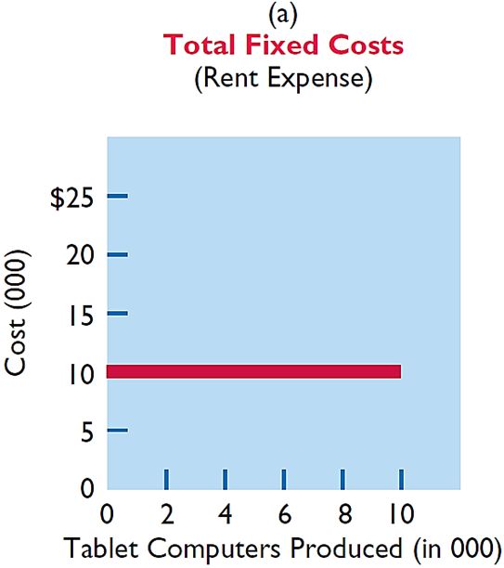
Fixed Costs (2 of 4)
Illustration: Damon Company leases its productive facilities at a cost of $10,000 per month. Total fixed costs of the facilities will remain constant at every level of activity, as part (a) of Illustration 22.2 shows.

Slide 12
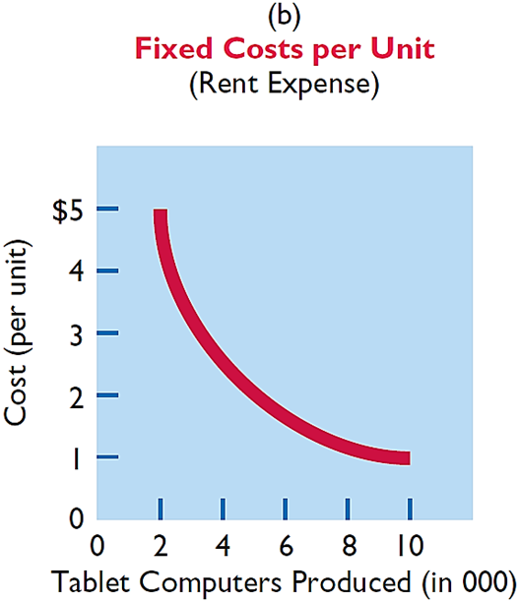
Fixed Costs (3 of 4)
Illustration: Damon Company leases its productive facilities at a cost of $10,000 per month. Total fixed costs of the facilities will remain constant at every level of activity. But, on a per unit basis, the cost of rent will decline as activity increases, as part (b) of Illustration 22.2 shows. At 2,000 units, the unit cost per tablet computer is $5 ($10,000 ÷ 2,000). When Damon produces 10,000 tablets, the unit cost of the rent is only $1 per tablet ($10,000 ÷ 10,000).

Slide 13
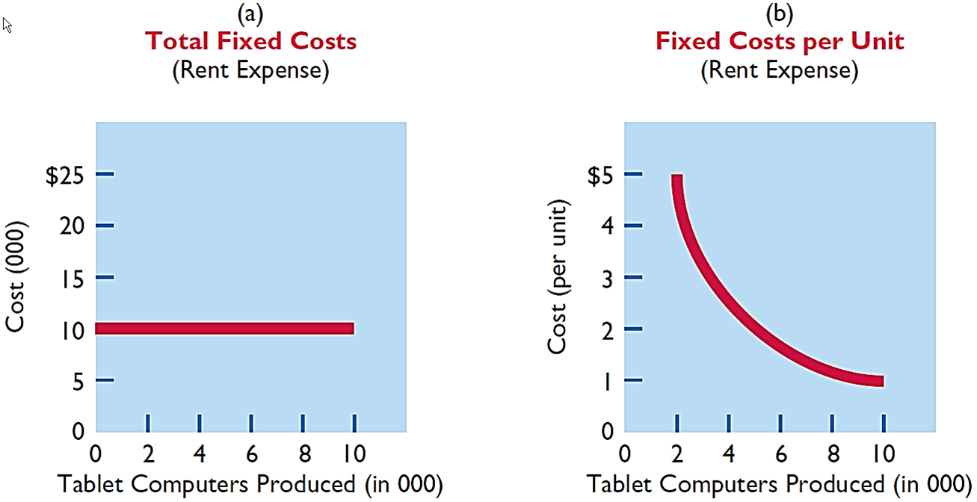
Fixed Costs (4 of 4)

Slide 14
Cost Behavior Analysis (4 of 5)
Variable costs are costs that:
a. Vary in total directly and proportionately with changes in the activity level.
b. Remain the same per unit at every activity level.
c. Neither of the above.
d. Both (a) and (b) above.

Slide 15
Cost Behavior Analysis (5 of 5)
Variable costs are costs that:
a. Vary in total directly and proportionately with changes in the activity level.
b. Remain the same per unit at every activity level.
c. Neither of the above.
d. Answer: Both (a) and (b) above.

Slide 16
Relevant Range (1 of 4)
Throughout the range of possible levels of activity, a straight-line relationship usually does not exist for either variable costs or fixed costs
Relationship between variable costs and changes in activity level is often curvilinear
For fixed costs, relationship is also nonlinear – some fixed costs will not change over entire range of activities, while other fixed costs may change

Slide 17
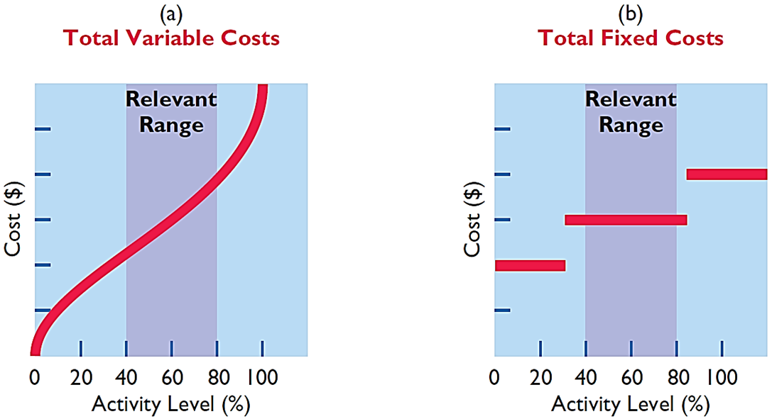
Relevant Range (2 of 4)
Range of activity over which a company expects to operate during a year.

Slide 18
Relevant Range (3 of 4)
The relevant range is:
a. The range of activity in which variable costs will be curvilinear.
b. The range of activity in which fixed costs will be curvilinear.
c. The range over which the company expects to operate during a year.
d. Usually from zero to 100% of operating capacity.

Slide 19
Relevant Range (4 of 4)
The relevant range is:
a. The range of activity in which variable costs will be curvilinear.
b. The range of activity in which fixed costs will be curvilinear.
c. Answer: The range over which the company expects to operate during a year.
d. Usually from zero to 100% of operating capacity.

Slide 20
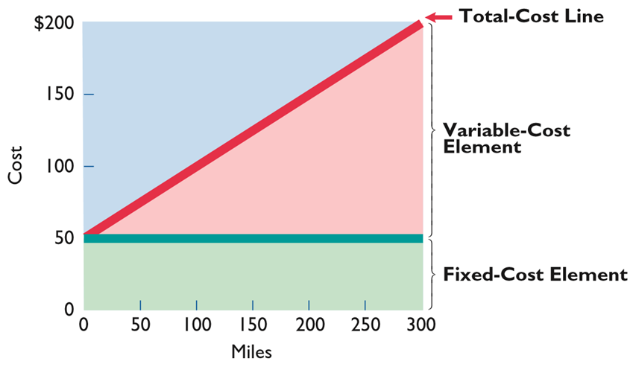
Mixed Costs
Costs that have both a variable element and a fixed element
Change in total but not proportionately with changes in activity level

Slide 21
Do It! 1: Types of Costs
Helena Company, reports the following total costs at two levels of production.
Classify each cost as variable, fixed, or mixed.
Classification | Cost | 10,000 Units | 20,000 Units
Variable | Direct materials | $20,000 | $40,000
Mixed | Maintenance | 8,000 | 10,000
Variable | Direct labor | 17,000 | 34,000
Variable | Indirect materials | 1,000 | 2,000
Fixed | Depreciation | 4,000 | 4,000
Mixed | Utilities | 3,000 | 5,000
Fixed | Rent | 6,000 | 6,000

Slide 22
Mixed Costs Analysis
For purposes of cost-volume-profit analysis, mixed costs must be classified into their fixed and variable elements.
High-Low Method
High-Low Method uses total costs incurred at high and low levels of activity to classify mixed costs into fixed and variable components
Difference in costs between high and low levels represents variable costs, since only variable-cost element can change as activity levels change

Slide 23
High-Low Method (1 of 5)
Step 1: Determine variable cost per unit using the following formula:

Slide 24
High-Low Method (2 of 5)
Illustration: Metro Transit Company has the following maintenance costs and mileage data for its fleet of buses over a 6-month period.
Month | Miles Driven | Total Cost | Month | Miles Driven | × | Total Cost
January | 20,000 | $30,000 | April | 50,000 |  | $63,000
February | 40,000 | 48,000 | May | 30,000 |  | 42,000
March | 35,000 | 49,000 | June | 43,000 |  | 61,000
Change in Costs
($63,000 − $30,000)
= $1.10 variable cost per unit
Difference in miles
(50,000 − 20,000)

Slide 25
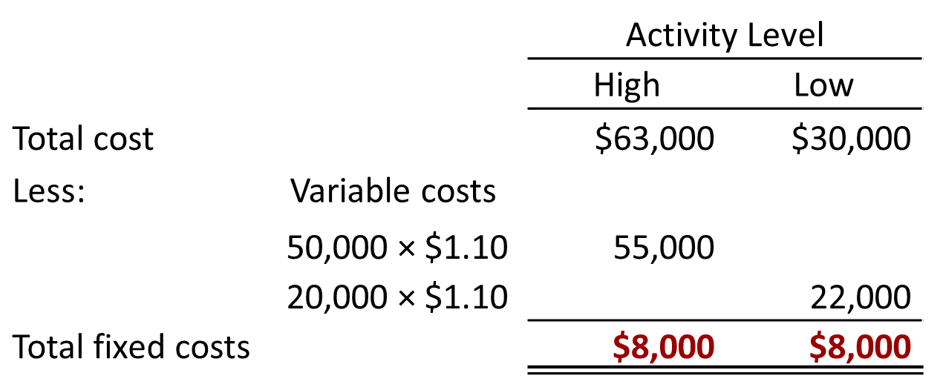
High-Low Method (3 of 5)
Illustration: Determine the total fixed cost for Metro Transit by subtracting the total variable cost at either the high or the low activity level from the total cost at that activity level.

Slide 26
High-Low Method (4 of 5)
Maintenance costs are therefore $8,000 per month of fixed costs plus $1.10 per mile of variable costs. This is represented by the following formula:
Maintenance costs = $8,000 + ($1.10 × Miles driven)
Example: At 45,000 miles, estimated maintenance costs would be:
Fixed
$ 8,000
Variable ($1.10 × 45,000)
49,500

Slide 27
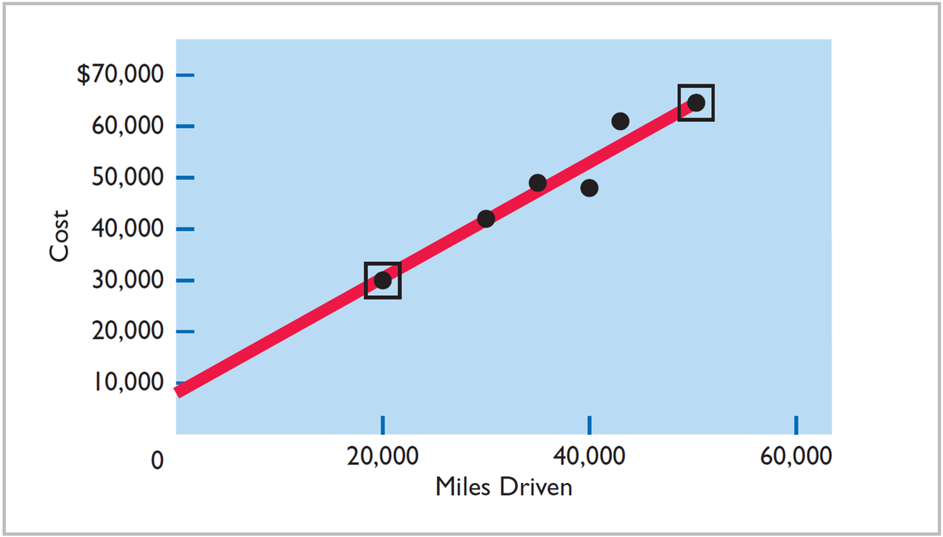
High-Low Method (5 of 5)

Slide 28
Mixed Cost (1 of 2)
Mixed costs consist of a:
a. Variable cost element and a fixed cost element.
b. Fixed cost element and a controllable cost element.
c. Relevant cost element and a controllable cost element.
d. Variable cost element and a relevant cost element.

Slide 29
Mixed Cost (2 of 2)
Mixed costs consist of a:
a. Answer: Variable cost element and a fixed cost element.
b. Fixed cost element and a controllable cost element.
c. Relevant cost element and a controllable cost element.
d. Variable cost element and a relevant cost element.

Slide 30
Importance of Identifying Variable and Fixed Costs (1 of 2)
Why is it important to segregate mixed costs into variable and fixed elements?
If American Airlines is to make a profit when it reduces all domestic fares by 30%, what reduction in costs or increase in passengers will be required?
To make a profit when it cuts domestic fares by 30%, American Airlines will have to increase the number of passengers or cut its variable costs for those flights. Its fixed costs will not change.

Slide 31
Importance of Identifying Variable and Fixed Costs (2 of 2)
Why is it important to segregate mixed costs into variable and fixed elements?
If Ford Motor Company meets workers’ demands for higher wages, what increase in sales revenue will be needed to maintain current profit levels?
Higher wages at Ford Motor Company will increase the variable costs of manufacturing automobiles. To maintain present profit levels, Ford will have to cut other variable or fixed costs, sell more automobiles, or increase the price of its automobiles.

Slide 32
Do It! 2: High-Low Method (1 of 4)
Byrnes Company accumulates the following data concerning a mixed cost, using units produced as the activity level.
 | Units Produced | Total Cost
March | 9,800 | $14,740
April | 8,500 | 13,250
May | 7,000 | 11,100
June | 7,600 | 12,000
July | 8,100 | 12,460
a. Compute variable-cost and fixed-cost elements using this method.
b. Using information from part (a), write the cost formula.
c. Estimate total cost if the company produces 8,000 units.

Slide 33
Do It! 2: High-Low Method (2 of 4)
 | Units Produced | Total Cost
March | 9,800 | $14,740
April | 8,500 | 13,250
May | 7,000 | 11,100
June | 7,600 | 12,000
July | 8,100 | 12,460
a. Compute variable-cost and fixed-cost elements using this method.
Fixed cost: $14,740 − $12,740 ($1.30 × 9,800 units) = $2,000
or $11,100 − $9,100 ($1.30 × 7,000) = $2,000

Slide 34
Do It! 2: High-Low Method (3 of 4)
 | Units Produced | Total Cost
March | 9,800 | $14,740
April | 8,500 | 13,250
May | 7,000 | 11,100
June | 7,600 | 12,000
July | 8,100 | 12,460
b. Using information from part (a), write the cost formula.
Cost = $2,000 + ($1.30 × units produced)

Slide 35
Do It! 2: High-Low Method (4 of 4)
 | Units Produced | Total Cost
March | 9,800 | $14,740
April | 8,500 | 13,250
May | 7,000 | 11,100
June | 7,600 | 12,000
July | 8,100 | 12,460
c. Estimate the total cost if the company produces 8,000 units.
Total cost (8,000 units):
$2,000 + $10,400 ($1.30 × 8,000) = $12,400

Slide 36
Cost-Volume-Profit Analysis (1 of 2)
Cost-volume-profit (C V P) analysis is the study of the effects of changes in costs and volume on a company’s profits.
Important in profit planning
Critical factor in management decisions such as
Setting selling prices
Determining product mix
Maximizing use of production facilities

Slide 37

Cost-Volume-Profit Analysis (2 of 2)
Basic Components

Slide 38
Basic Components (1 of 3)
Assumptions
Behavior of both costs and revenues is linear throughout the relevant range of the activity index.
Costs can be classified accurately as either variable or fixed.
Changes in activity are the only factors that affect costs.
All units produced are sold.
When more than one type of product is sold, the sales mix will remain constant.

Slide 39
Basic Components (2 of 3)
Which of the following is not involved in C V P analysis
a. Sales mix
b. Unit selling prices
c. Fixed costs per unit
d. Volume or level of activity

Slide 40
Basic Components (3 of 3)
Which of the following is not involved in C V P analysis
a. Sales mix
b. Unit selling prices
c. Answer: Fixed costs per unit
d. Volume or level of activity

Slide 41
C V P Income Statement (1 of 3)
A statement for internal use
Classifies costs and expenses as fixed or variable
Reports contribution margin in body of statement
Contribution margin – amount of revenue remaining after deducting variable costs
Reports same net income as a traditional income statement

Slide 42
C V P Income Statement (2 of 3)
Illustration: Vargo Electronics Company produces cell phones. Relevant data for the cell phones sold by this company in June 2020 are as follows.
Unit selling price of cell phone | $500
Unit variable costs* | $300
Total monthly fixed costs** | $200,000
Units sold | 1,600
*Includes variable manufacturing costs and variable selling and administrative expenses.
**Includes fixed manufacturing costs and fixed selling and administrative expenses.

Slide 43
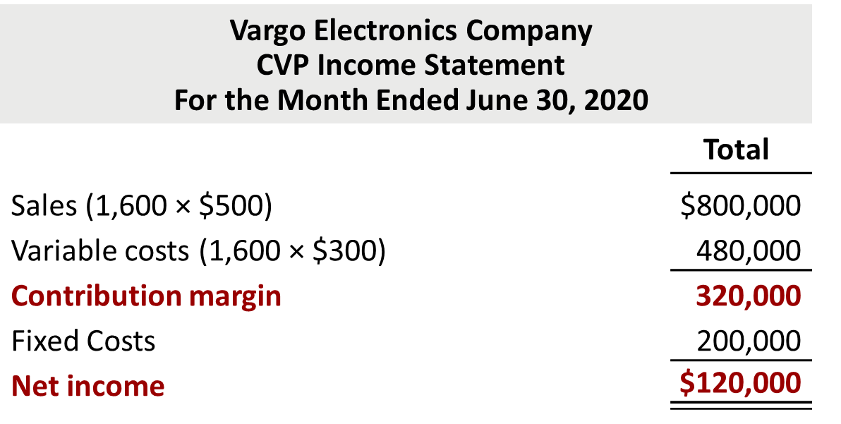
C V P Income Statement (3 of 3)
Illustration: The C V P income statement for Vargo Electronics therefore would be reported as follows.

Slide 44
Unit Contribution Margin (1 of 6)
Contribution margin is available to cover fixed costs and to contribute to income
Formula for unit contribution margin and the computation for Vargo Electronics are:

Slide 45
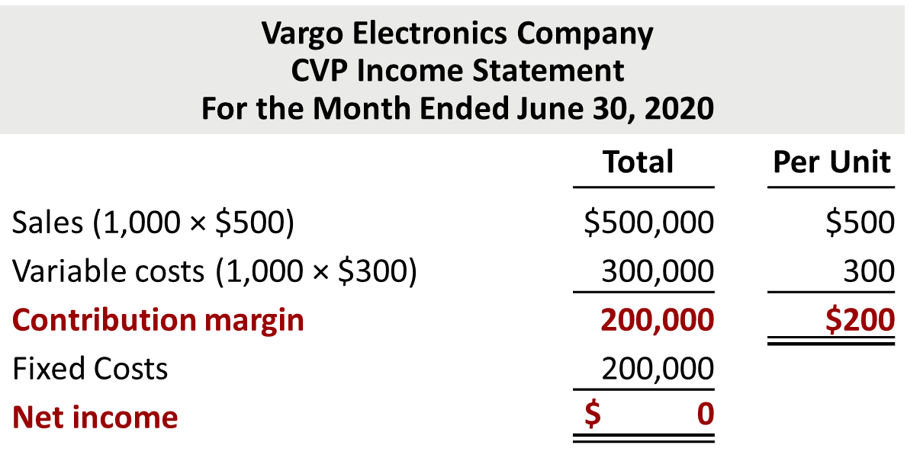
Unit Contribution Margin (2 of 6)
Vargo’s C V P income statement assuming a zero net income.

Slide 46

Unit Contribution Margin (3 of 6)
Assume that Vargo sold a total of 1,001 cell phones.

Slide 47
Unit Contribution Margin (4 of 6)
Shows the percentage of each sales dollar available to apply toward fixed costs and profits
Formula for contribution margin ratio and the computation for Vargo Electronics are:

Slide 48
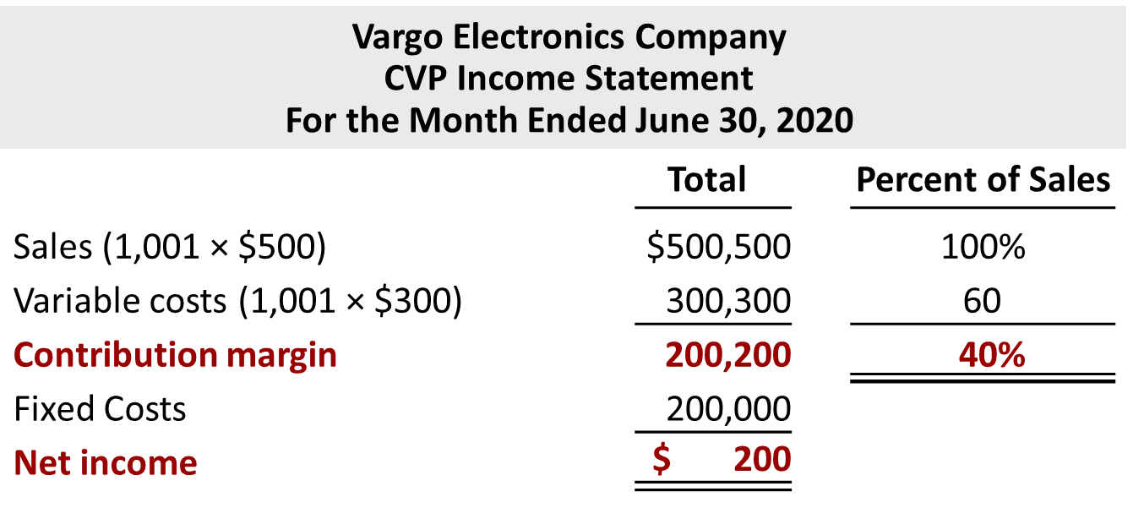
Unit Contribution Margin (5 of 6)
C V P income statement, with net income and percent of sales data.

Slide 49
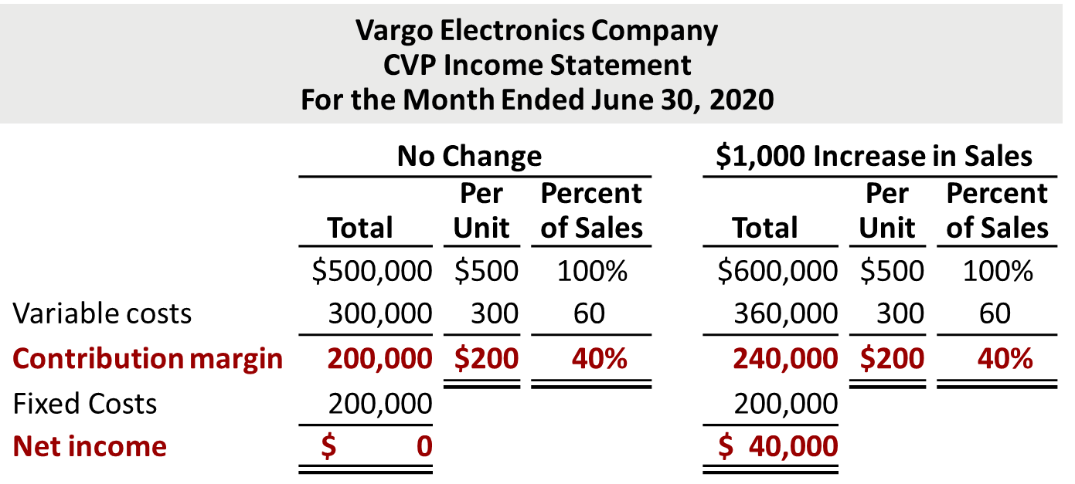
Unit Contribution Margin (6 of 6)
Assume Vargo Electronics’s current sales are $500,000 and it wants to know the effect of a $100,000 (200-unit) increase in sales.

Slide 50
Contribution Margin (1 of 2)
Contribution margin:
a. Is revenue remaining after deducting variable costs.
b. May be expressed as contribution margin per unit.
c. Is selling price less cost of goods sold.
d. Both (a) and (b) above.

Slide 51
Contribution Margin (2 of 2)
Contribution margin:
a. Is revenue remaining after deducting variable costs.
b. May be expressed as contribution margin per unit.
c. Is selling price less cost of goods sold.
d. Answer: Both (a) and (b) above.

Slide 52
Do It! 3: C V P Income Statement (1 of 2)
Ampco Industries produces and sells a cell phone-operated thermostat. Information regarding the costs and sales of thermostats during September 2020 are provided below.
Unit selling price of thermostat | $85
Unit variable costs | $32
Total monthly fixed costs | $190,000
Units sold | 4,000
Prepare a C V P income statement for Ampco Industries for the month of September. Provide per unit values and total values.

Slide 53
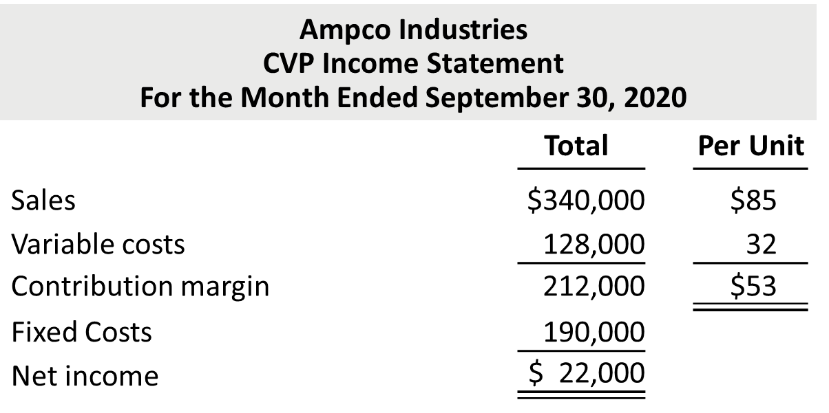
Do It! 3: C V P Income Statement (2 of 2)
Prepare a C V P income statement for Ampco Industries for the month of September. Provide per unit values and total values.

Slide 54
Break-Even Analysis (1 of 3)
Process of finding break-even point level of activity at which total revenues equal total costs (both fixed and variable)
Can be computed or derived
from a mathematical equation,
by using contribution margin, or
from a cost-volume profit (C V P) graph.
Expressed either in sales units or in sales dollars

Slide 55
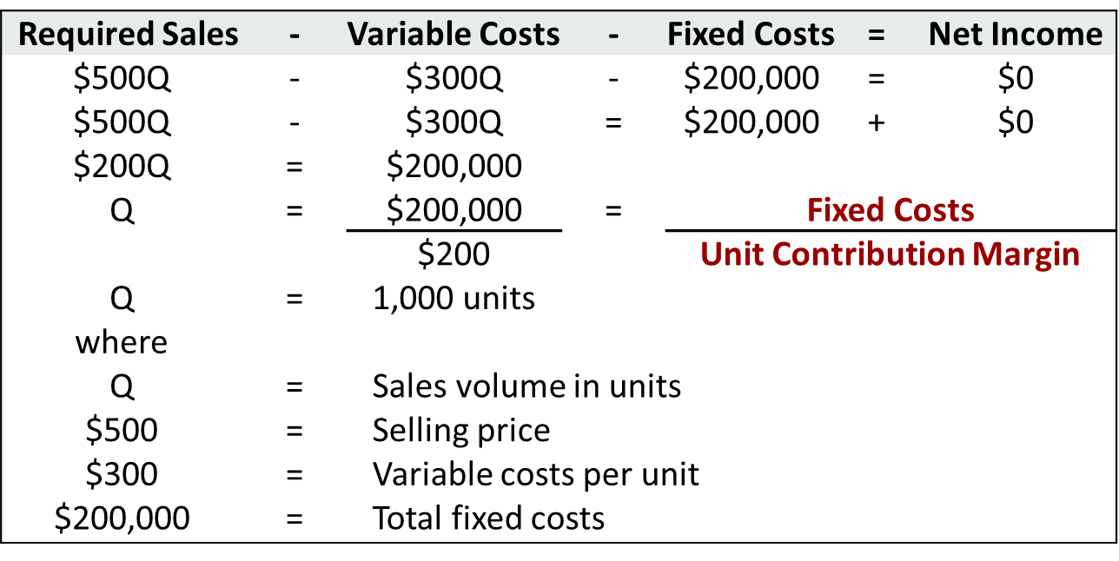
Mathematical Equation (1 of 2)
Break-even occurs where total sales equal variable costs plus fixed costs; that is, net income is zero.

Slide 56
Contribution Margin Technique (1 of 3)
At the break-even point, contribution margin must equal total fixed costs
(C M = total revenues – variable costs)
Break-even point can be computed using either contribution margin per unit or contribution margin ratio

Slide 57
Contribution Margin Technique (2 of 3)
Contribution Margin in Units
When break-even-point in units is desired, contribution margin per unit is used in the following formula which shows computation for Vargo Electronics:

Slide 58
Contribution Margin Technique (3 of 3)
Contribution Margin Ratio
When break-even-point in dollars is desired, contribution margin ratio is used in the following formula which shows computation for Vargo Electronics:

Slide 59
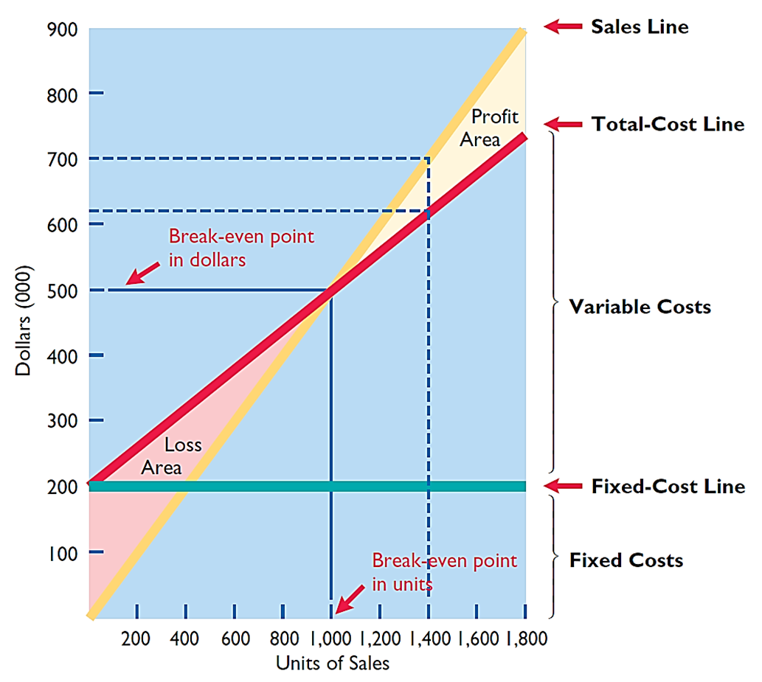
Graphic Presentation

Slide 60
Break-Even Analysis (2 of 3)
Gossen Company is planning to sell 200,000 pliers for $4 per unit. The contribution margin ratio is 25%. If Gossen will break even at this level of sales, what are the fixed costs?
a. $100,000
b. $160,000
c. $200,000
d. $300,000

Slide 61
Break-Even Analysis (3 of 3)
Gossen Company is planning to sell 200,000 pliers for $4 per unit. The contribution margin ratio is 25%. If Gossen will break even at this level of sales, what are the fixed costs?
a. $100,000
b. $160,000
c. Answer: $200,000
d. $300,000

Slide 62
Do It! 4: Break-Even Analysis (1 of 2)
Lombardi Company has a unit selling price of $400, variable costs per unit of $240, and fixed costs of $180,000. Compute the break-even point in units using (a) a mathematical equation

Slide 63
Do It! 4: Break-Even Analysis (2 of 2)
Lombardi Company has a unit selling price of $400, variable costs per unit of $240, and fixed costs of $180,000. Compute the break-even point in units using (b) contribution margin per unit.

Slide 64
Target Net Income and Margin of Safety
Target Net Income
Level of sales necessary to achieve a target income
Can be determined from each approach used to determine break-even sales/units:
from a mathematical equation,
by using contribution margin technique, or
from a cost-volume profit (C V P) graph
Expressed either in sales units or in sales dollars

Slide 65
Target Net Income (1 of 6)
Mathematical Equation
Formula for required sales to meet target net income.

Slide 66
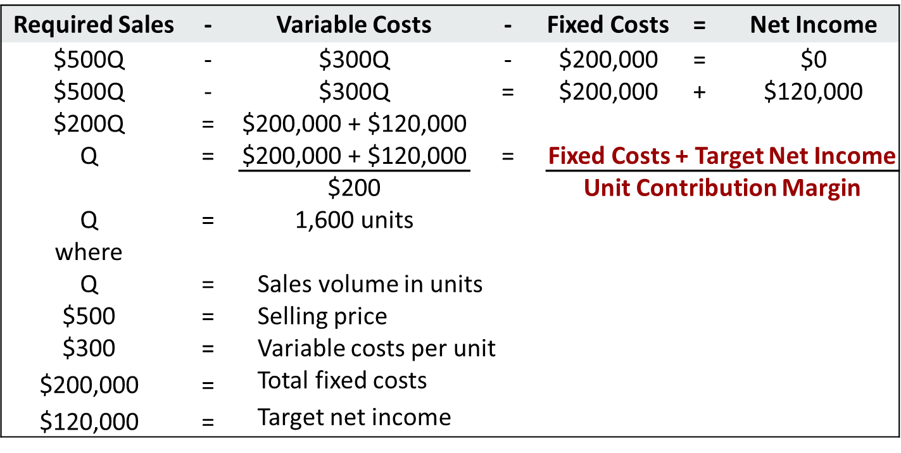
Mathematical Equation (2 of 2)
Break-even point formula including desired net income.

Slide 67
Target Net Income (2 of 6)
Contribution Margin Technique
To determine required sales in units for Vargo Electronics:

Slide 68
Target Net Income (3 of 6)
Contribution Margin Technique
To determine required sales in dollars for Vargo Electronics:

Slide 69

Target Net Income (4 of 6)
Graphic Presentation
Suppose Vargo Electronics sells 1,400 cell phones. Illustration 22.23 shows that a vertical line drawn at 1,400 units intersects the sales line at $700,000 and the total cost line at $620,000. The difference between the two amounts represents the net income (profit) of $80,000.

Slide 70
Target Net Income (5 of 6)
The mathematical equation for computing required sales to obtain target net income is:
Required sales =
a. Variable costs + Target net income
b. Variable costs + Fixed costs + Target net income
c. Fixed costs + Target net income
d. No correct answer is given

Slide 71
Target Net Income (6 of 6)
The mathematical equation for computing required sales to obtain target net income is:
Required sales =
a. Variable costs + Target net income
b. Answer: Variable costs + Fixed costs + Target net income
c. Fixed costs + Target net income
d. No correct answer is given

Slide 72
Margin of Safety
Difference between actual or expected sales and sales at break-even point
Measures “cushion” that a particular level of sales provides
May be expressed in dollars or as a ratio
Assuming actual/expected sales are $750,000:

Slide 73
Margin of Safety Ratio
Computed by dividing margin of safety in dollars by actual (or expected) sales
Higher dollars or percentage, greater margin of safety
Assuming actual/expected sales are $750,000:

Slide 74
Do It! 5: Break-Even, Margin of Safety, and Target Net Income (1 of 4)
Zootsuit Inc. makes travel bags that sell for $56 each. For the coming year, management expects fixed costs to total $320,000 and variable costs to be $42 per unit. Compute the following:
a. Break-even point in dollars using the contribution margin (C M) ratio
b. Margin of safety and margin of safety ratio assuming actual sales are $1,382,400
c. Sales dollars required to earn net income of $410,000

Slide 75
Do It! 5: Break-Even, Margin of Safety, and Target Net Income (2 of 4)
Zootsuit Inc. makes travel bags that sell for $56 each. For the coming year, management expects fixed costs to total $320,000 and variable costs to be $42 per unit. Compute the break-even point in dollars using the contribution margin (C M) ratio.
Contribution margin ratio =
[($56 − $42) ÷ $56] = 25%
Break-even sales in dollars =
$320,000 ÷ 25% = $1,280,000

Slide 76
Do It! 5: Break-Even, Margin of Safety, and Target Net Income (3 of 4)
Zootsuit Inc. makes travel bags that sell for $56 each. For the coming year, management expects fixed costs to total $320,000 and variable costs to be $42 per unit. Compute the margin of safety and margin of safety ratio assuming actual sales are $1,382,400.
Margin of safety =
$1,382,400 − $1,280,000 = $102,400
Margin of safety ratio =
$102,400 ÷ $1,382,400 = 7.4%

Slide 77
Do It! 5: Break-Even, Margin of Safety, and Target Net Income (4 of 4)
Zootsuit Inc. makes travel bags that sell for $56 each. For the coming year, management expects fixed costs to total $320,000 and variable costs to be $42 per unit. Compute the sales dollars required to earn net income of $410,000.
Sales in dollars =
($320,000 + $410,000) ÷ 25% = $2,920,000

Slide 78
Appendix 22A: Regression Analysis (1 of 8)
While the high-low method works well, a weakness is that it employs only a few data points and ignores the rest.
If those two data points are representative of the entire data set, then the high-low method provides reasonable results.
If the high and low data points are not representative of the rest of the data set, then the results are misleading.

Slide 79
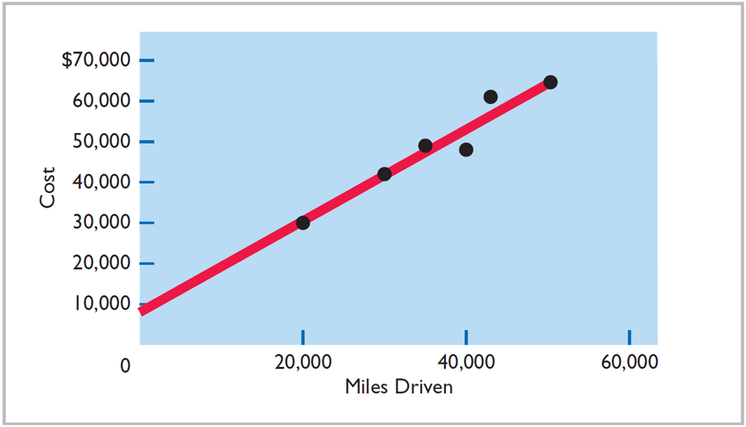
Appendix 22A: Regression Analysis (2 of 8)
While the high-low method works well, a weakness is that it employs only a few data points and ignores the rest.

Slide 80
Appendix 22A: Regression Analysis (3 of 8)
Illustration: Assume that Hanson Trucking Company has 12 months of maintenance cost data, as shown.
Month | Miles Driven | Total Cost | Month | Miles Driven | Total Cost
January | 20,000 | $30,000 | July | 15,000 | $39,000
February | 40,000 | 49,000 | August | 28,000 | 41,000
March | 35,000 | 46,000 | September | 60,000 | 72,000
April | 50,000 | 63,000 | October | 55,000 | 67,000
May | 30,000 | 42,000 | November | 19,000 | 29,000
June | 43,000 | 52,000 | December | 65,000 | 63,000
Variable Cost per unit under high-low method:
Difference in Maintenance cost = ($63,000 − $39,000) = $24,000
Difference in Miles driven = 65,000 − 15,000 = 50,000 miles
Variable cost/unit = $24,000 ÷ 50,000 miles = $0.48

Slide 81
Appendix 22A: Regression Analysis (4 of 8)
Month | Miles Driven | Total Cost | Month | Miles Driven | Total Cost
January | 20,000 | $30,000 | July | 15,000 | $39,000
February | 40,000 | 49,000 | August | 28,000 | 41,000
March | 35,000 | 46,000 | September | 60,000 | 72,000
Total variable cost = number of miles x cost per mile.
At the low activity level of 15,000 miles, total variable cost is $7,200 (15,000 × $0.48).
To determine fixed costs, subtract total variable costs at the low activity level from the total cost at the low activity level.
Fixed costs = $39,000 − ($0.48 × 15,000) = $31,800

Slide 82
Appendix 22A: Regression Analysis (5 of 8)
Regression analysis is a statistical approach that estimates the cost equation by employing information from all data points, not just highest and lowest ones
Regression analysis finds a cost equation that results in a cost equation line that minimizes the sum of (squared) distances from line to data points

Slide 83
Regression Analysis
Illustration 22A.4, uses the Intercept and Slope functions in Excel to estimate the regression equation for the Hanson Trucking Company data.
Intercept:
=INTERCEPT (C2:C13,B2:B13) = 18,502
Slope:
=SLOPE (C2:C13,B2:B13) = 0.81
 | A | B | C | D
1 | Month | Miles Driven | Total Cost
2 | January | 20,000 | $30,000
3 | February | 40,000 | 49,000
4 | March | 35,000 | 46,000
5 | April | 50,000 | 63,000
6 | May | 30,000 | 42,000
7 | June | 43,000 | 52,000
8 | July | 15,000 | 39,000
9 | August | 28,000 | 41,000
10 | September | 60,000 | 72,000
11 | October | 55,000 | 67,000
12 | November | 190,000 | 29,000
13 | December | 65,000 | 63,000
14

Slide 84
Appendix 22A: Regression Analysis (6 of 8)
The resulting cost equation is:
Compare this to the high-low cost equation:

Slide 85
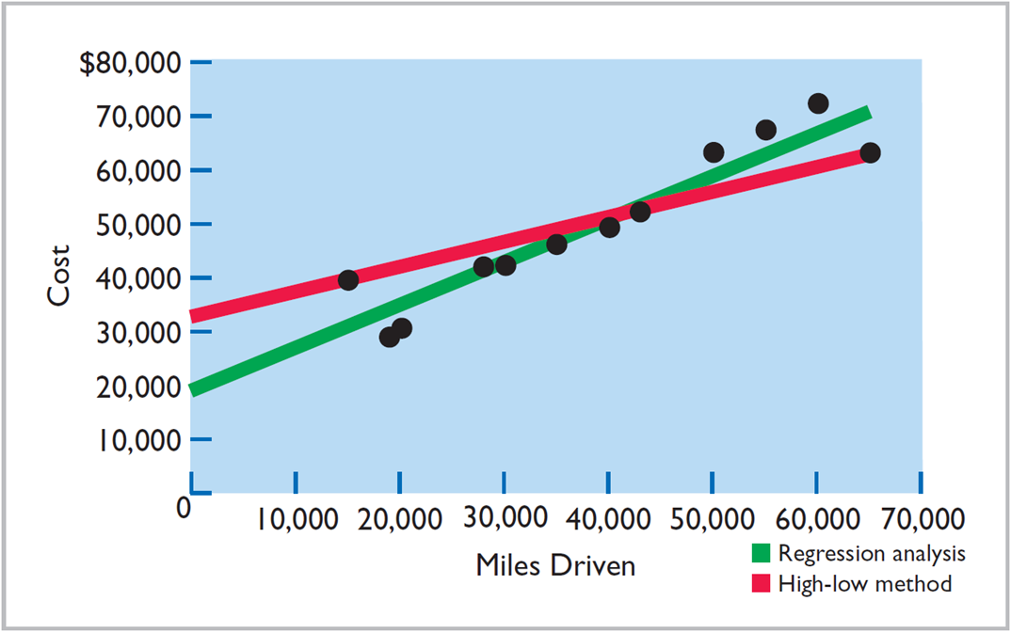
Appendix 22A: Regression Analysis (7 of 8)
The intercept and slope differ significantly between the regression equation (green) and the high-low equation (red).

Slide 86
Appendix 22A: Regression Analysis (8 of 8)
While regression analysis usually provides more reliable estimates of the cost equation, it does have limitations.
The regression approach applied above assumes a linear relationship between the variables. If the actual relationship differs significantly from linearity, then linear regression can provide misleading results.
Regression estimates can be severely influenced by “outliers”—data points that differ significantly from the rest of the observations.
Regression estimation is most accurate when it is based on a large number of data points.

Slide 87
Copyright
Copyright © 2018 John Wiley & Sons, Inc.
All rights reserved. Reproduction or translation of this work beyond that permitted in Section 117 of the 1976 United States Act without the express written permission of the copyright owner is unlawful. Request for further information should be addressed to the Permissions Department, John Wiley & Sons, Inc. The purchaser may make back-up copies for his/her own use only and not for distribution or resale. The Publisher assumes no responsibility for errors, omissions, or damages, caused by the use of these programs or from the use of the information contained herein.

